Slide 1
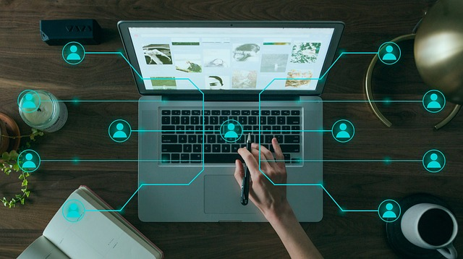
Dmm PROJECT
Submitted by: Muhammad Usman Batch No : 83

Slide 2
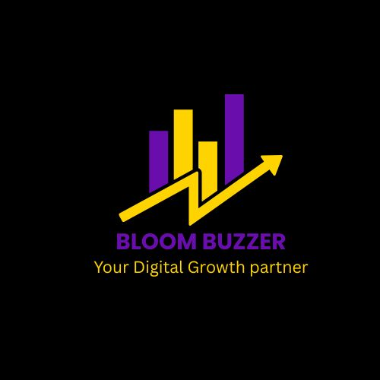
SocIAL media marketing
In today’s fast-paced digital world, your audience lives online — and so should your brand. At Bloom Buzzer, we help businesses stand out, connect, and grow through strategic Social Media Marketing.
Our SMM Services Include:
✅ Social Media Strategy Development ✅ Content Creation & Design ✅ Page Management & Scheduling ✅ Audience Engagement ✅ Paid Advertising Campaigns ✅ Analytics & Growth Reports
Why Choose Bloom Buzzer? Tailored strategies for your unique brand Results-driven campaigns Expertise across all major platforms

Slide 3
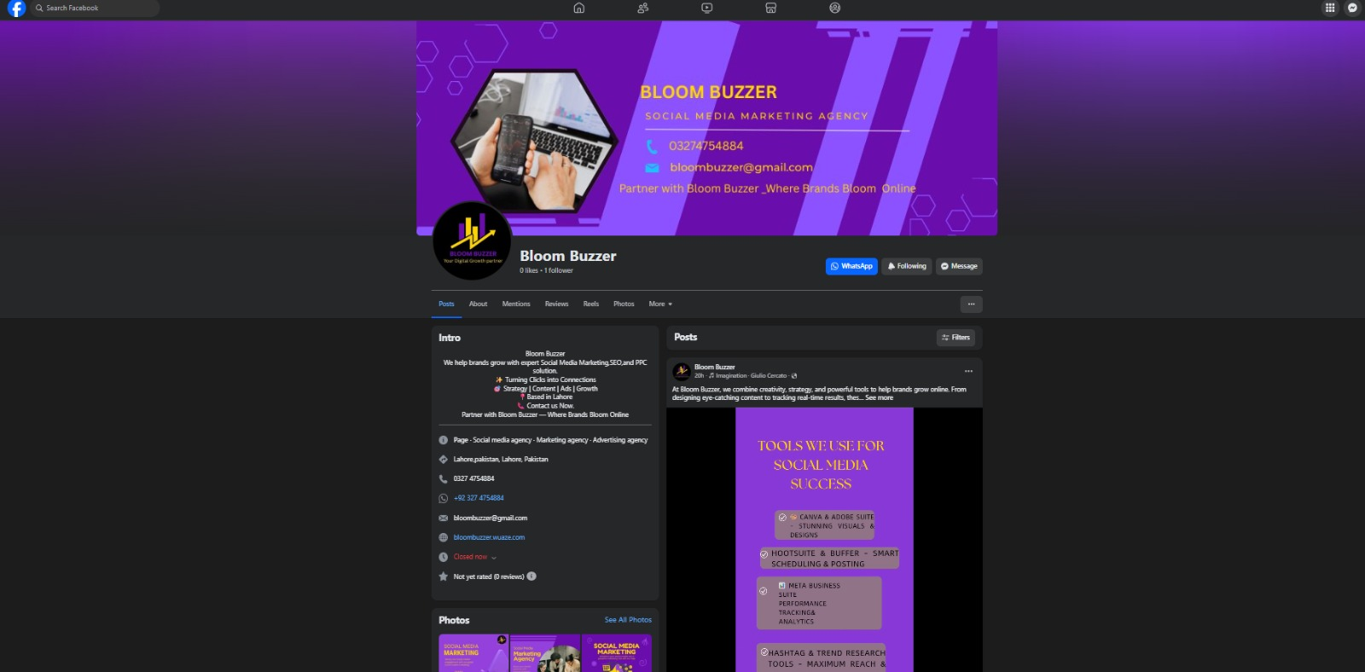
Facebook business page
https://www.facebook.com/bloombuzzer10

Slide 4
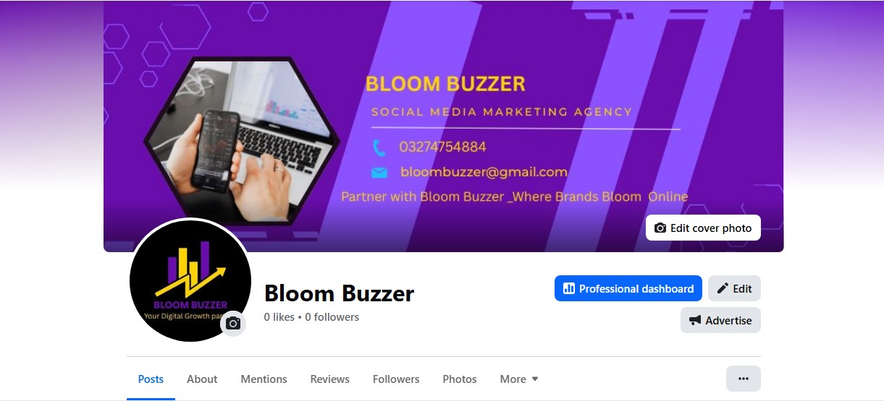
FACEBOOK LOGO + COVER PHOTO

Slide 5
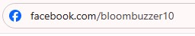
Facebook optimization

Slide 6
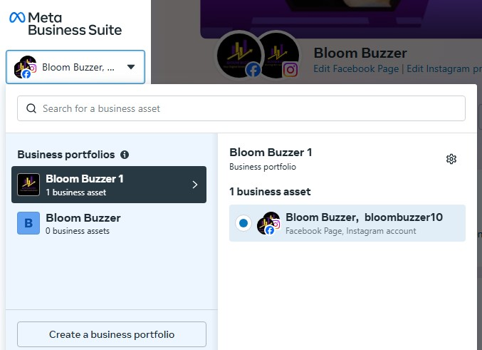
Business portfolios account

Slide 7
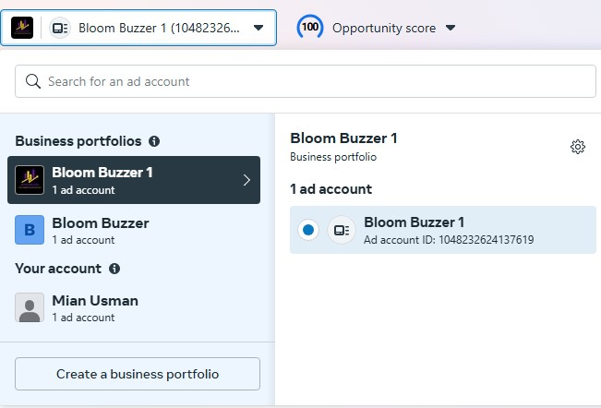
AD ACCOUNT

Slide 8
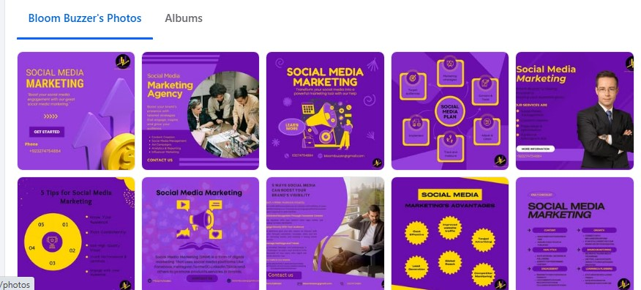
FACEBOOK POSTS

Slide 9
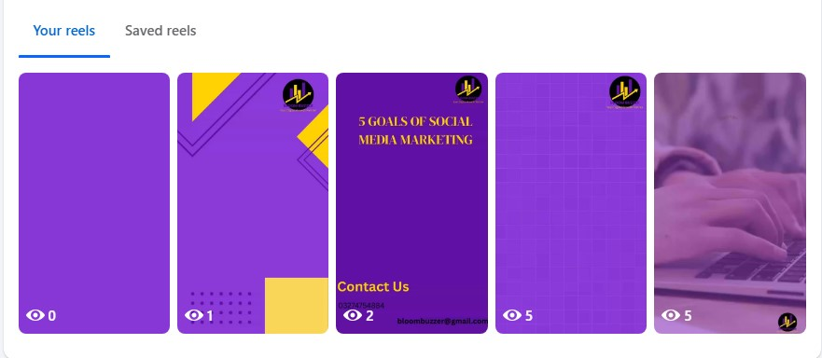
FACEBOOK REELS

Slide 10
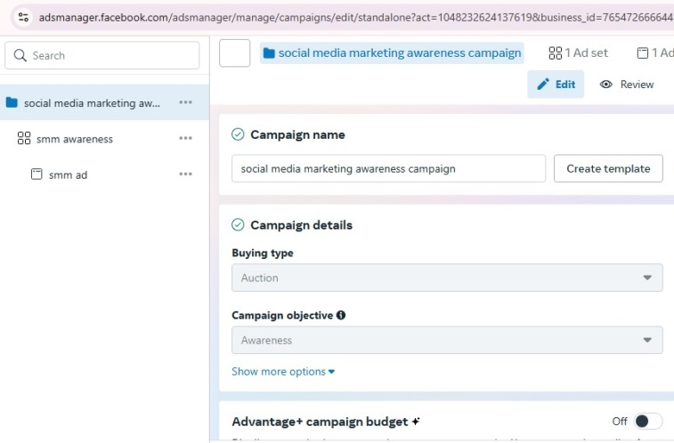
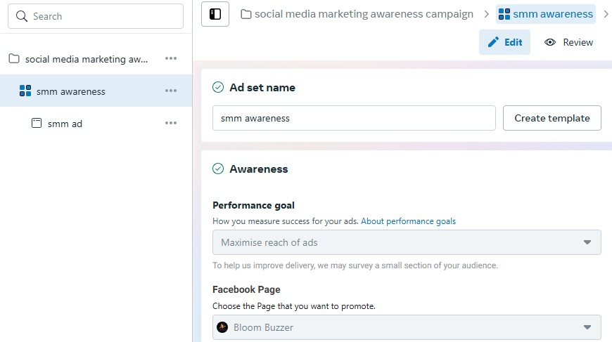
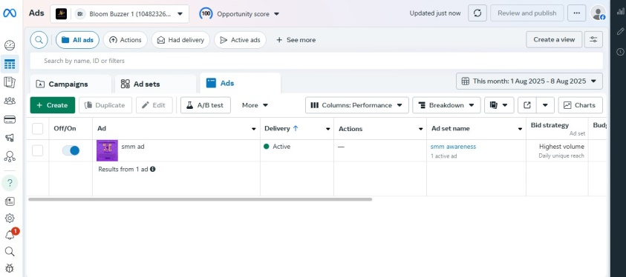
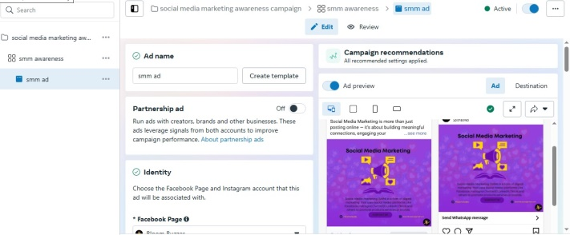
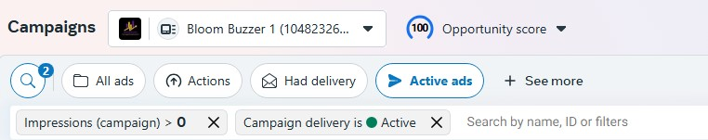
MANAGE AD CAMPAIGN AND RUN AWARENESS AD:

Slide 11
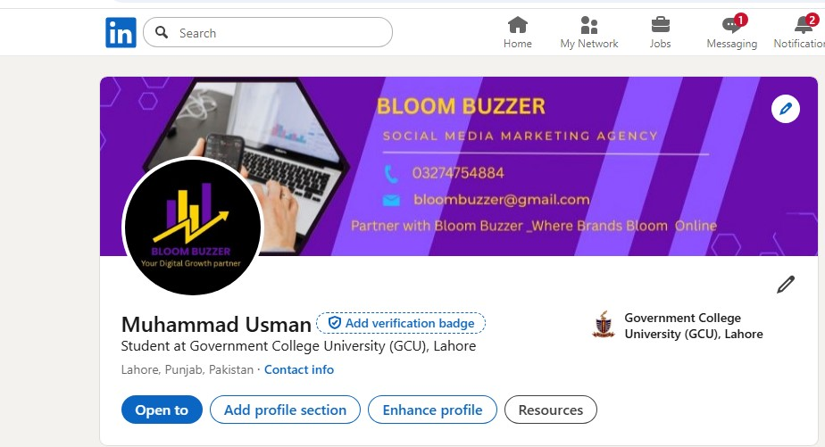
Linkedin PROFILE

Slide 12
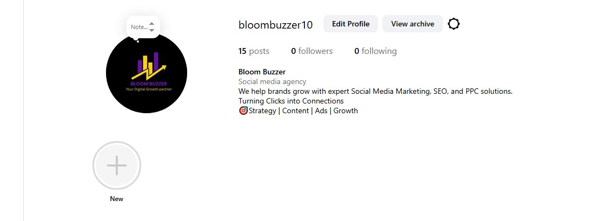
INSTAGRAM BUSINESS PROFILE

Slide 13
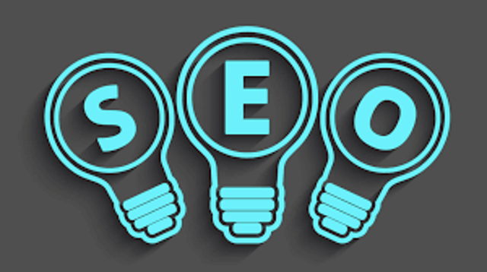
SEO

Slide 14
Search engine optimization
Seo(Search Engine Optimization) SEO (Search Engine Optimization) is the process of improving your website so it appears higher on search engines like Google, Bing, and Yahoo. When your site ranks higher, more people can find your business, which increases traffic, leads, and sales. Main types of SEO: > On-page SEO >Off-page SEO >Technical SEO

Slide 15
Define types:
1 On-page SEO >Title tags >Meta description >Heading(H1,H2,H3) >Keywords in content >Image alt text 2 Off-page SEO >Backlinks from other websites >Social media sharing >Guest posting

Slide 16
3 Technical SEO >Website speed >Mobile-friendliness >SSL(HTTPS) >XML sitemap >Robots.txt >Fixing errors

Slide 17
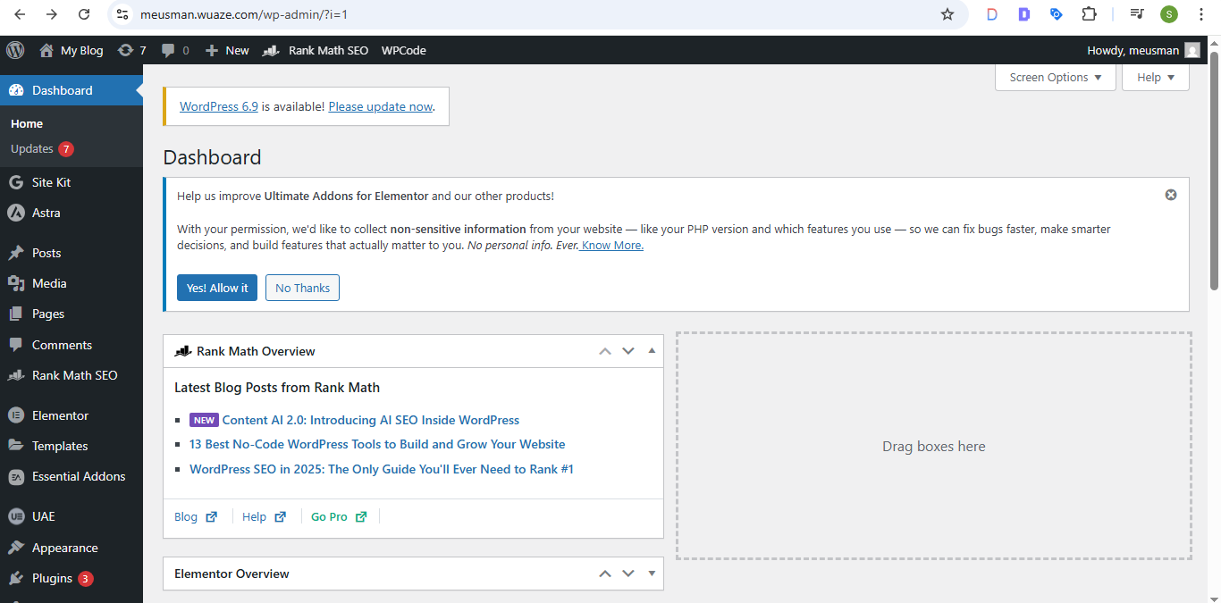
DasHboard:

Slide 18
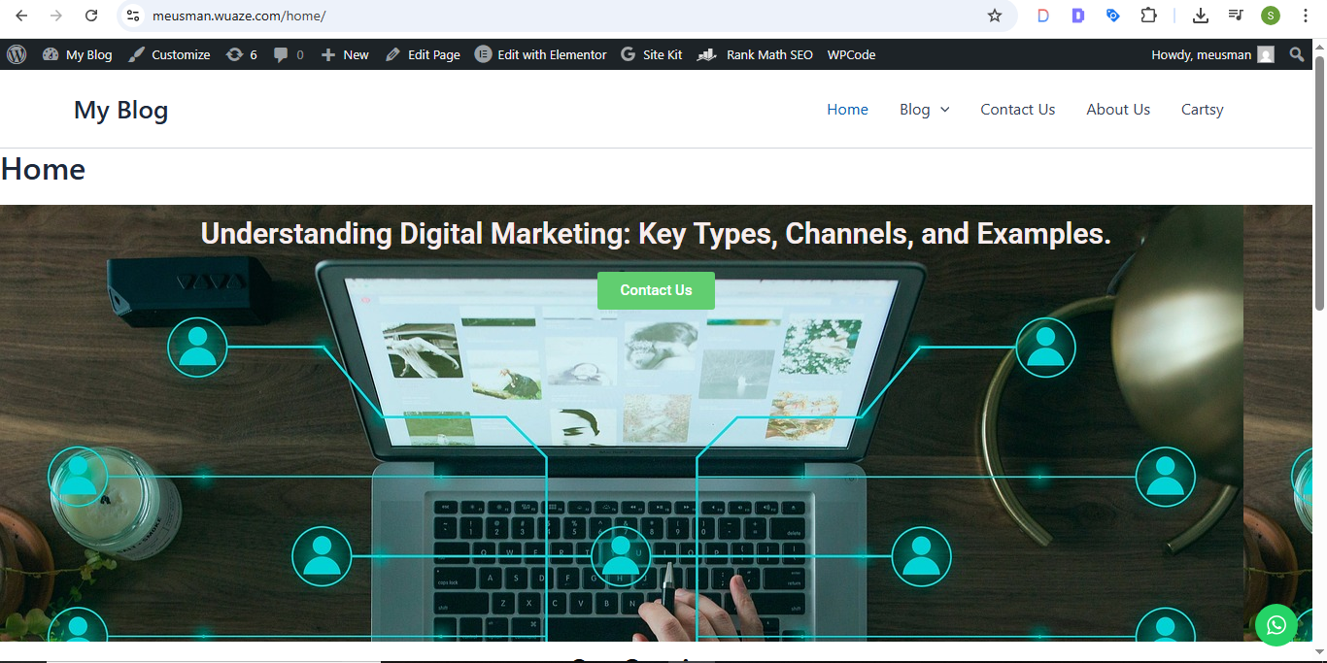
HOME PAGE:

Slide 19
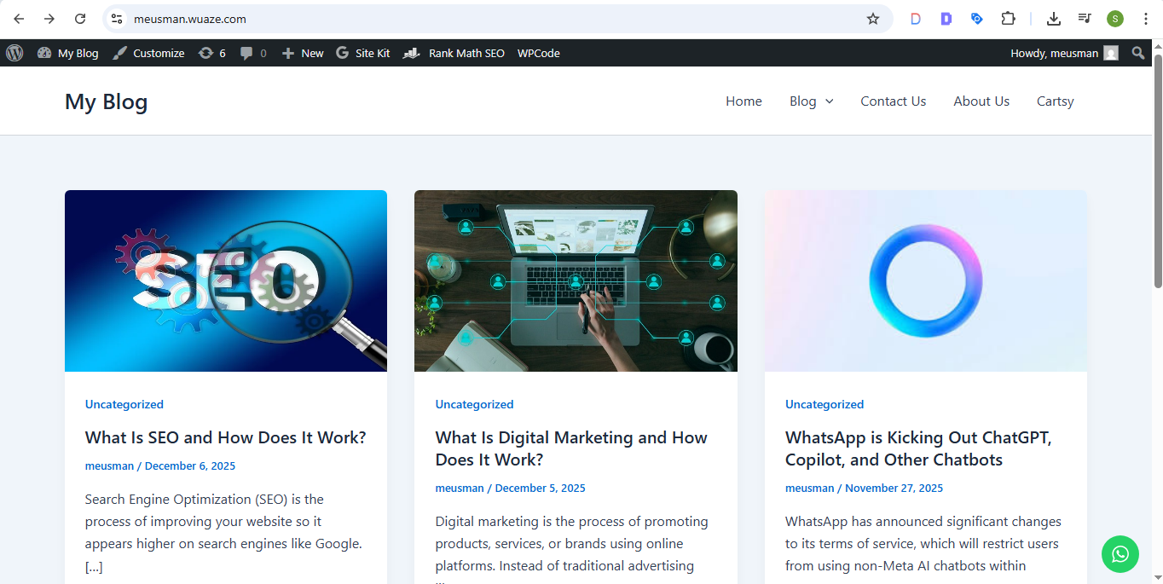
POSTS:

Slide 20
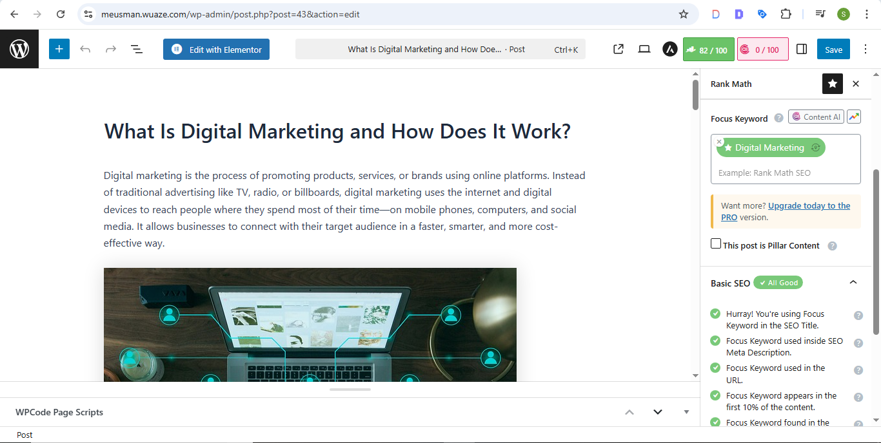
ARTICLE WITH RANKMATH SCORE:

Slide 21
KEYWORD:
A keyword is a word or phrase that people type into search engines (like Google) to find information. In SEO, keywords help search engines understand what your content is about.
Example
If someone searches:
“Best smart watches in Pakistan” Then the keyword is “smart watches in Pakistan”.

Slide 22
TYPE OF KEYWORDS:
1. Short-Tail Keywords:
>1–2 words
Example: “watches”, “SEO tips”
>High search volume, high competition.
2. Long-Tail Keywords:
>3+ words
Example: “best budget smart watches in Pakistan”
>Low competition, easier to rank.
3. Buyer-Intent Keywords:
>Used when people want to buy something
Example: “buy smart watch online”
4. Informational Keywords:
>For learning
Example: “what is SEO”

Slide 23
5. LSI Keywords (Latent Semantic Indexing)
>These are related or similar keywords that help Google understand your topic better. Example: Main keyword: “smart watch” >LSI keywords: “fitness tracker”, “Bluetooth watch”, “health monitoring watch”
6. Branded Keywords >Keywords that include a brand name. Example: >“Apple Watch Series 9”
>“Ravlexx smart watches”
7. Non-Branded Keywords
>Keywords without a brand name. Example:
“best smart watches”

Slide 24
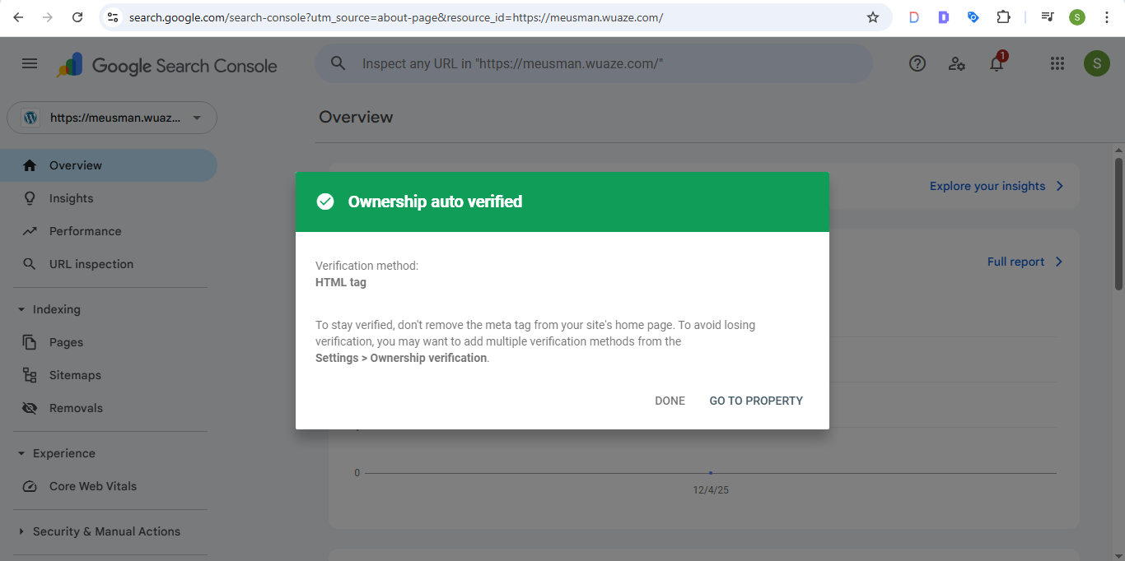
Intigration of google search console:

Slide 25
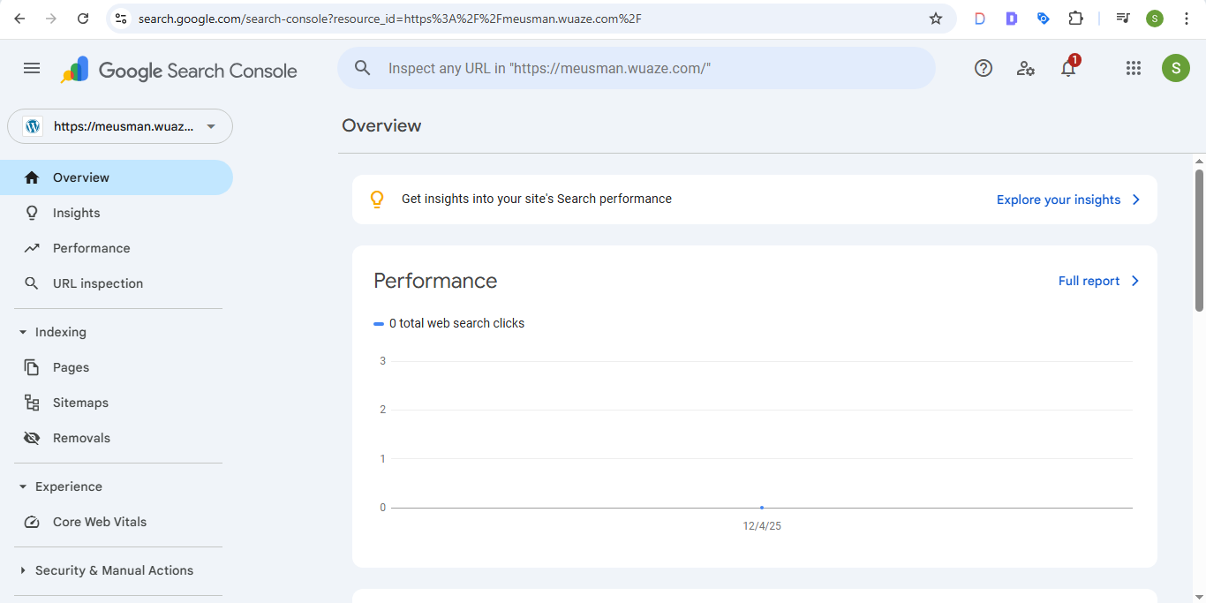
GSC (overview board):

Slide 26
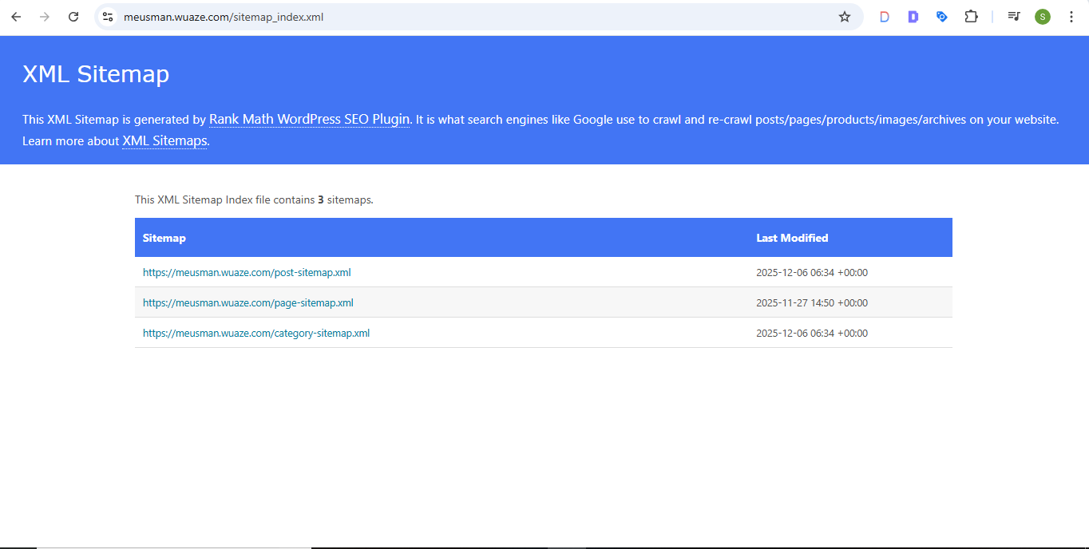
sitemap:

Slide 27
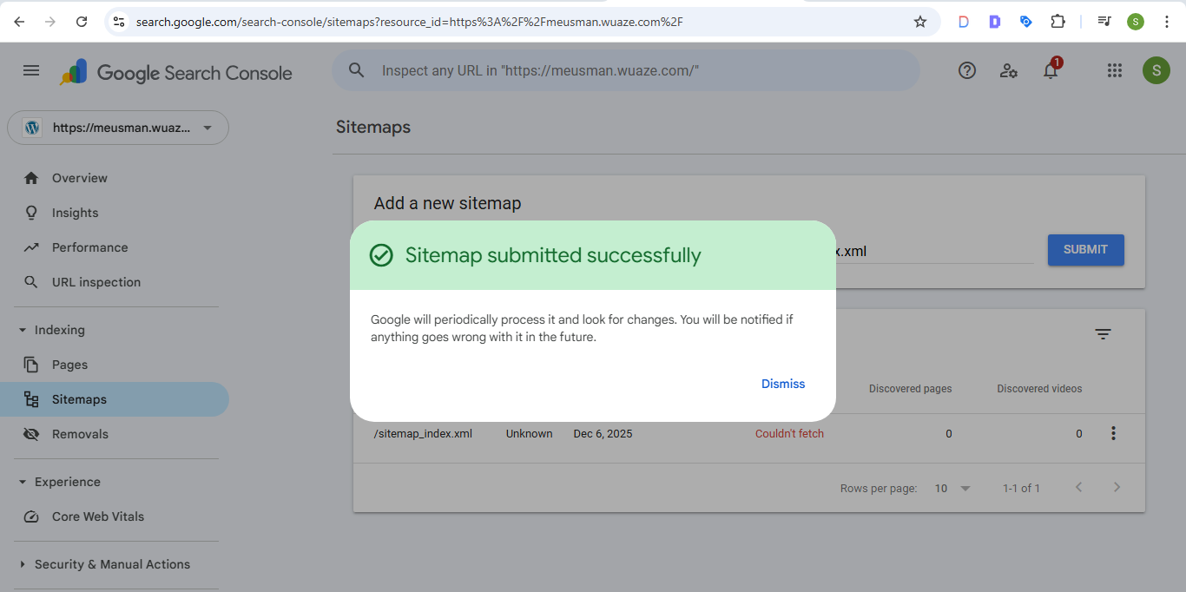
Submit sitemap in gsc:

Slide 28
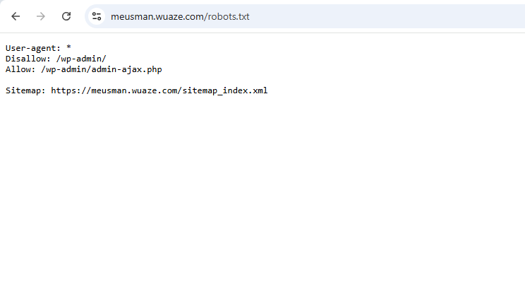
ROBOTS.TXT FILE:

Slide 29
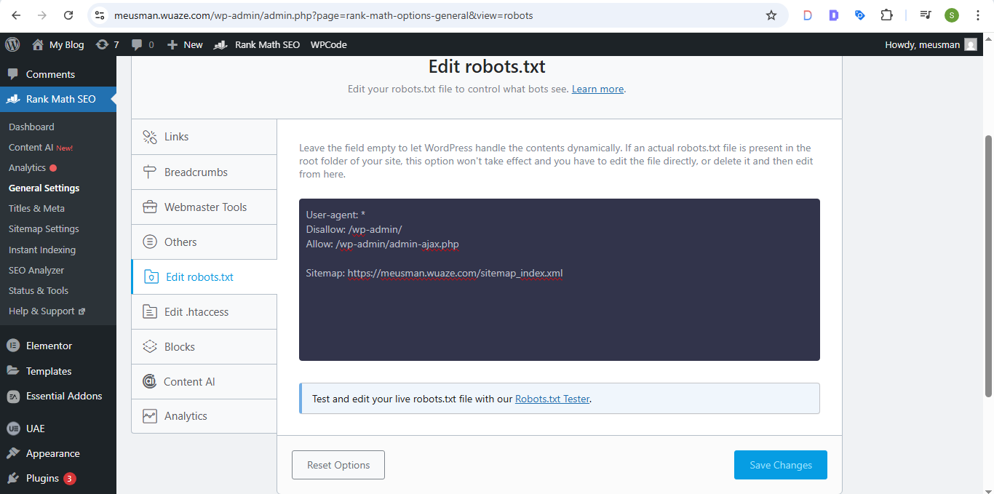
EDIT ROBOTS.TXT FILE IN RANKMATH

Slide 30
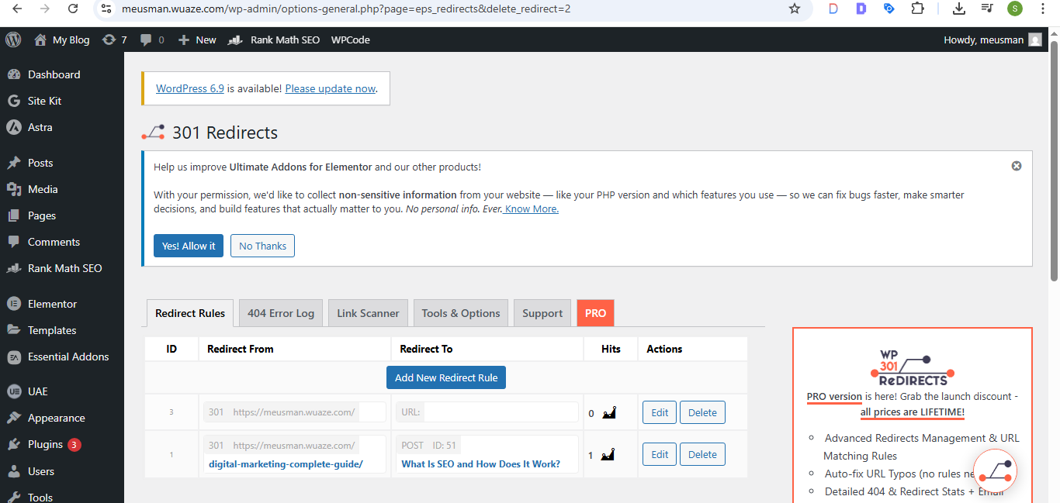
REDIRECTION:

Slide 31
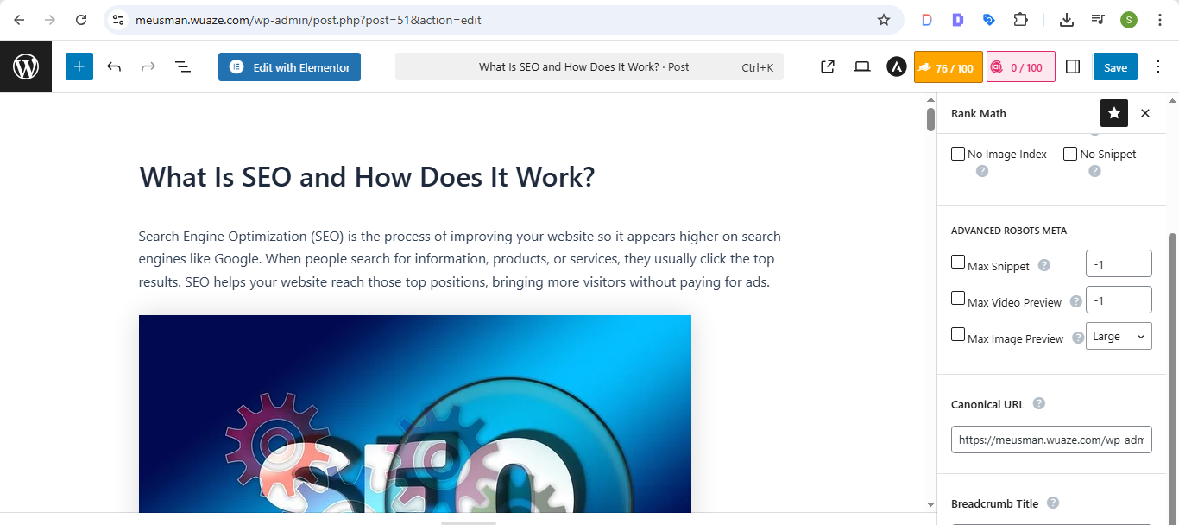
CANONICAL TAGS:

Slide 32
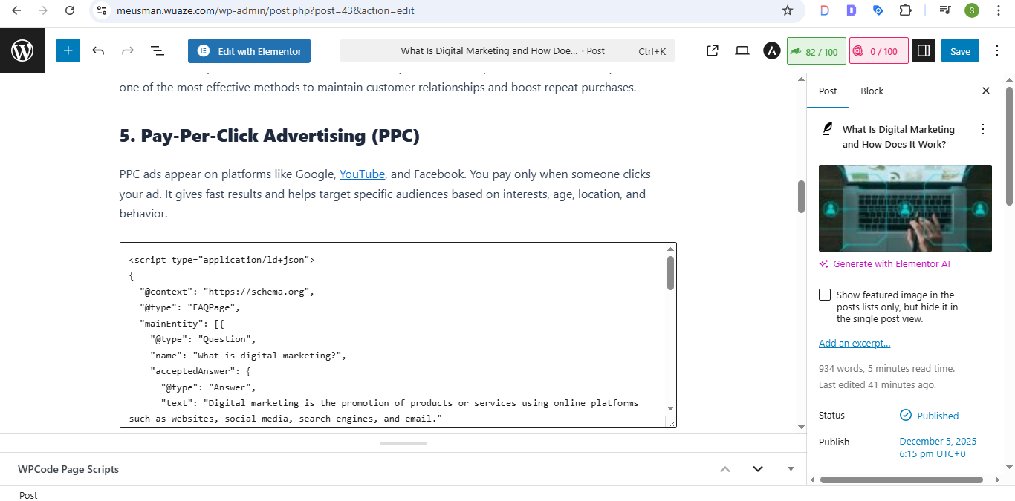
Schema markup:

Slide 33
SERP (SEARCH ENGINE RESULTS PAGE):
SERP stands for Search Engine Results Page.
It is the page you see on Google or any search engine after you type a query. In simple words:
SERP = The page that shows all the results for your search.
What appears on a SERP?
Organic Results (normal website listings)
Paid Ads (sponsored results at top or bottom)
Featured Snippets (the highlighted quick answer box)
People Also Ask section
Knowledge Panel (information box on the side)
Images / Videos results
Local Map Pack (local business results)

Slide 34
⭐ Crawling
>Crawling is the process where search engine bots (like Googlebot) visit websites to discover new pages and updates. Bots follow links from one page to another to collect information.
⭐ Indexing
>Indexing is when Google stores and organizes crawled pages in its database. If a page is indexed, it can appear in search results.
⭐ Ranking
>Ranking means where your page appears on the SERP. Higher ranking = your page appears at the top of search results.
⭐ Crawl Budget
>Crawl budget is the number of pages a search engine bot will crawl on your website within a given time. Large websites need good crawl budget so bots can crawl all pages.

Slide 35
⭐ Dwell Time
>Dwell time is the time a user spends on your page after clicking it from the SERP before returning back to Google. Longer dwell time = better content quality.
⭐ Pogo Sticking
>Pogo sticking happens when a user clicks a search result, opens the page, quickly comes back to the SERP, and clicks another result. This shows that the first page didn’t satisfy the user.
⭐ Bounce Rate
>Bounce rate is the percentage of visitors who open your page and leave without visiting another page on your website. High bounce rate = poor user engagement.
⭐ CTR (Click-Through Rate)
>CTR is the percentage of people who see your page on SERP and click on it. Higher CTR = better title, meta description, and relevance.

Slide 36
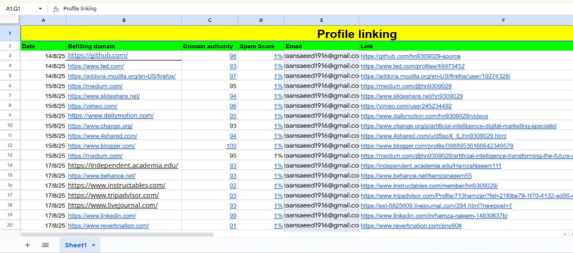
BACKLINKS SHEET:

Slide 37
Broken link & broken link tool:
A broken link (also called a dead link or 404 link) is a hyperlink on a website that no longer works. When a user clicks it, the page does not open and usually shows a 404 error. >Screaming Frog SEO Spider
>Google Search Console
>Dead Link Checker

Slide 38
Lost link & lost link tool:
A Lost Link Tool is an SEO tool used to identify backlinks that your website had in the past but have now been removed, deleted, or lost. >Ahrefs – Lost Backlinks Report
>SEMrush – Backlink Audit (Lost Links)
>Moz Link Explorer – Lost Links

Slide 39
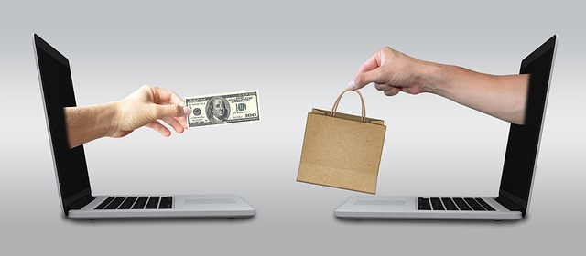
E- COMMERCE

Slide 40
Shopify:
Shopify is an e-commerce platform that allows you to create, manage, and grow an online store without needing advanced technical skills. ⭐ Simple Explanation: Create your own online shop
Add products (like watches, clothes, accessories, etc.)
Accept payments (Card, COD, PayPal, etc.)
Track orders & manage customers
Customize your store design easily

Slide 41
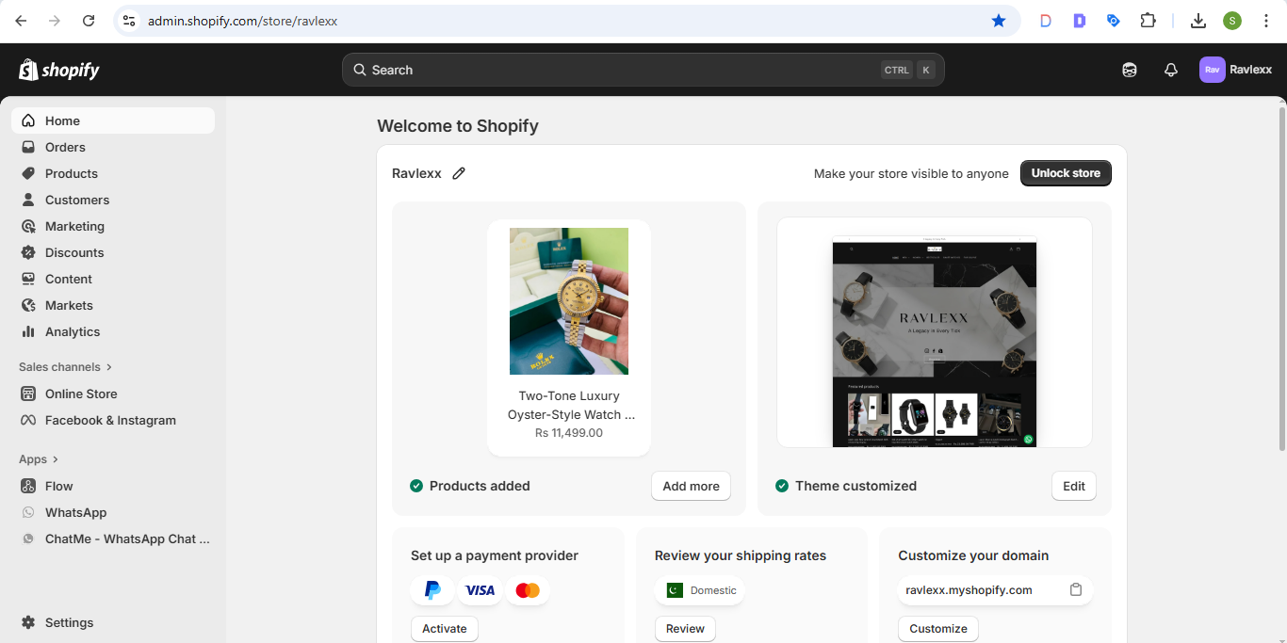
Shopify DASHBOARD:

Slide 42
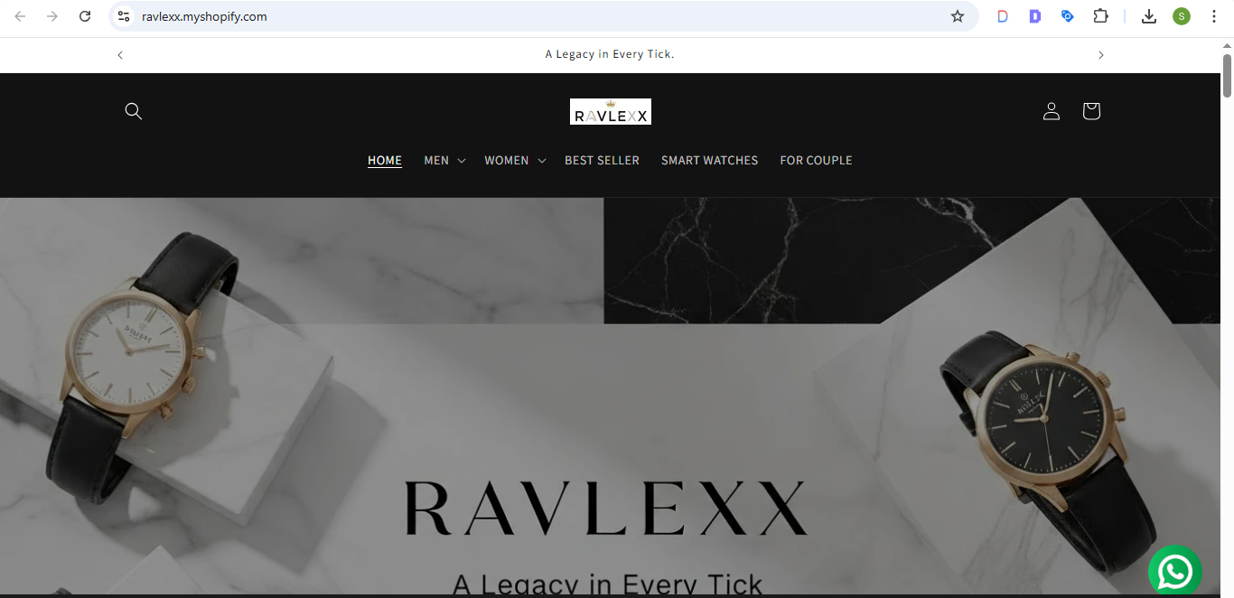
SHOPIFY STORE:

Slide 43
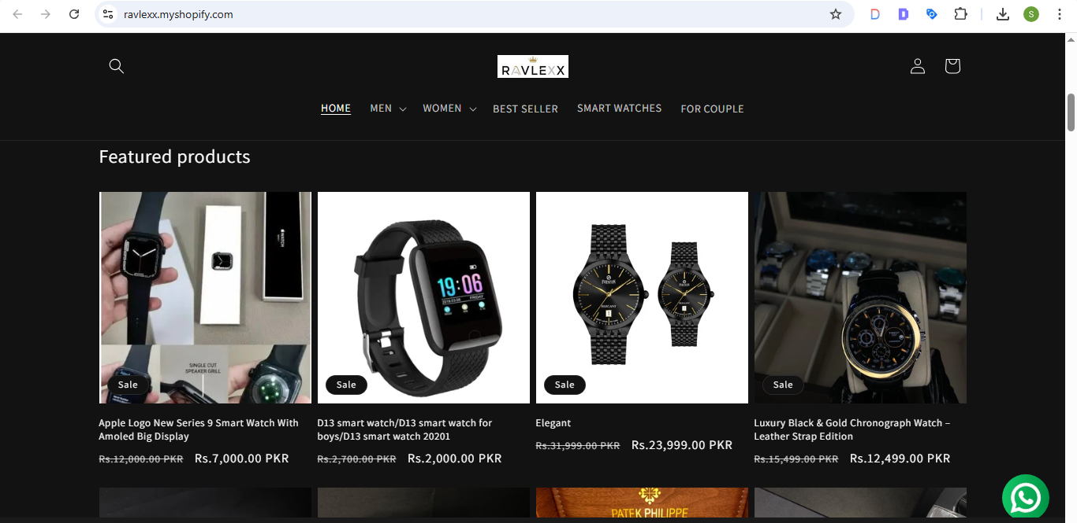
PRODUCT LISTING:

Slide 44
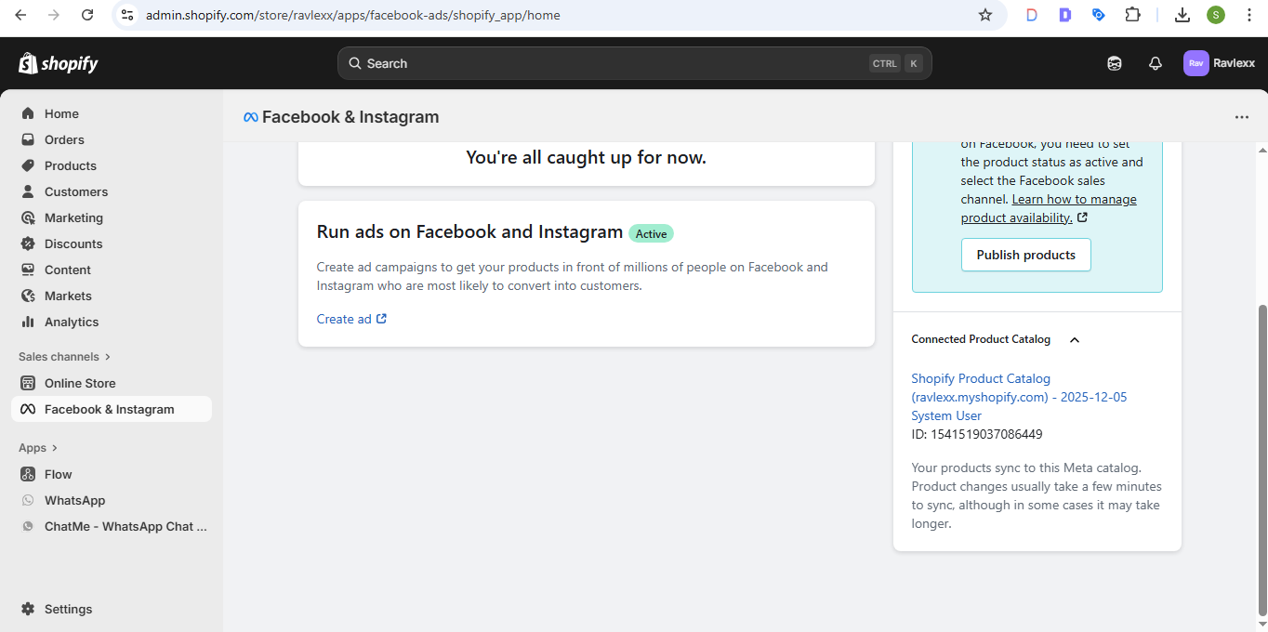
Facebook & INSTAGRAM :

Slide 45
Google search console:

Slide 46
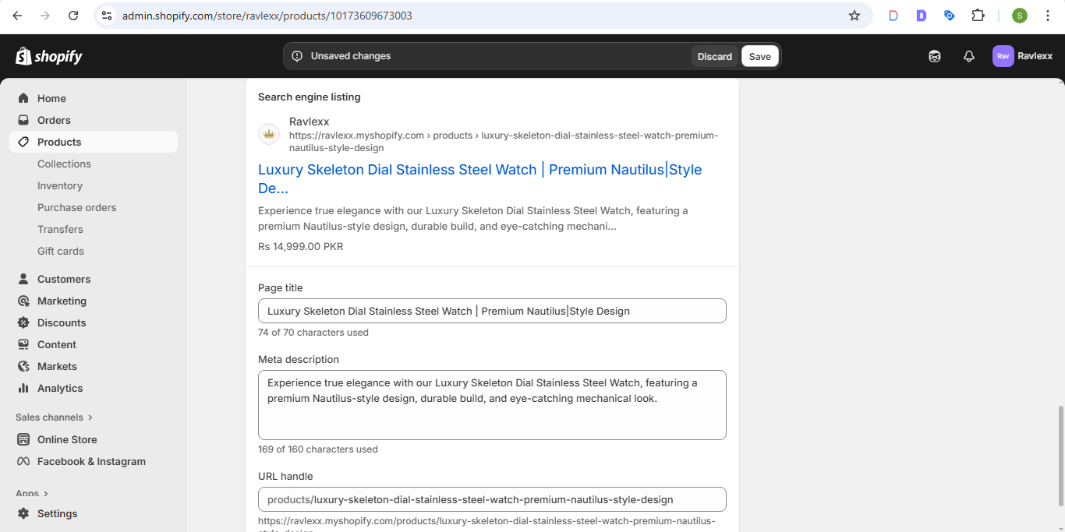
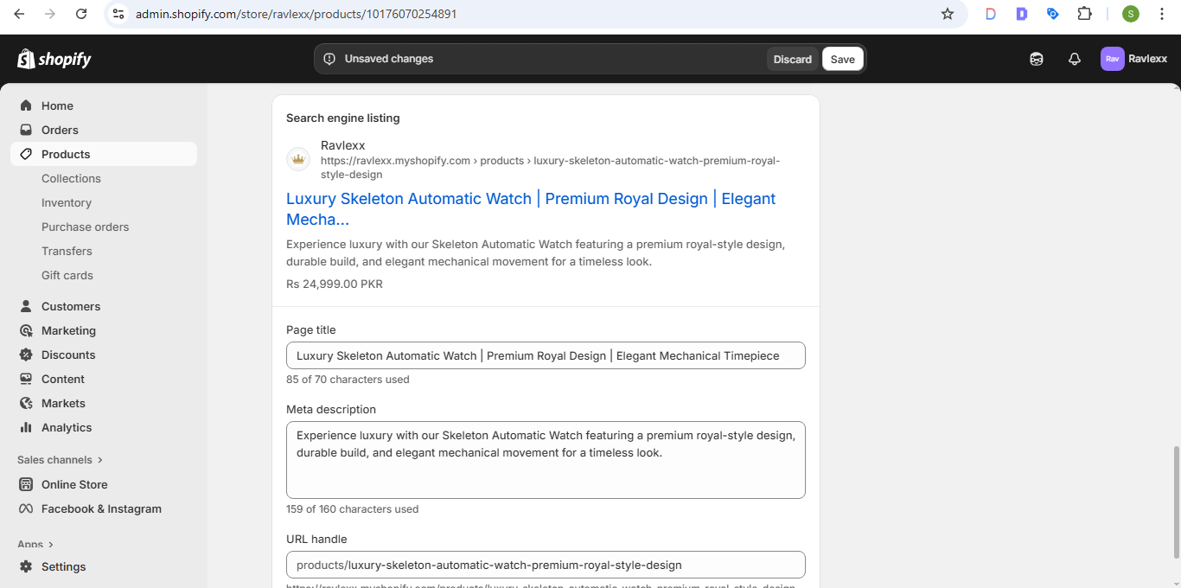
SEO TAGS:

Slide 47
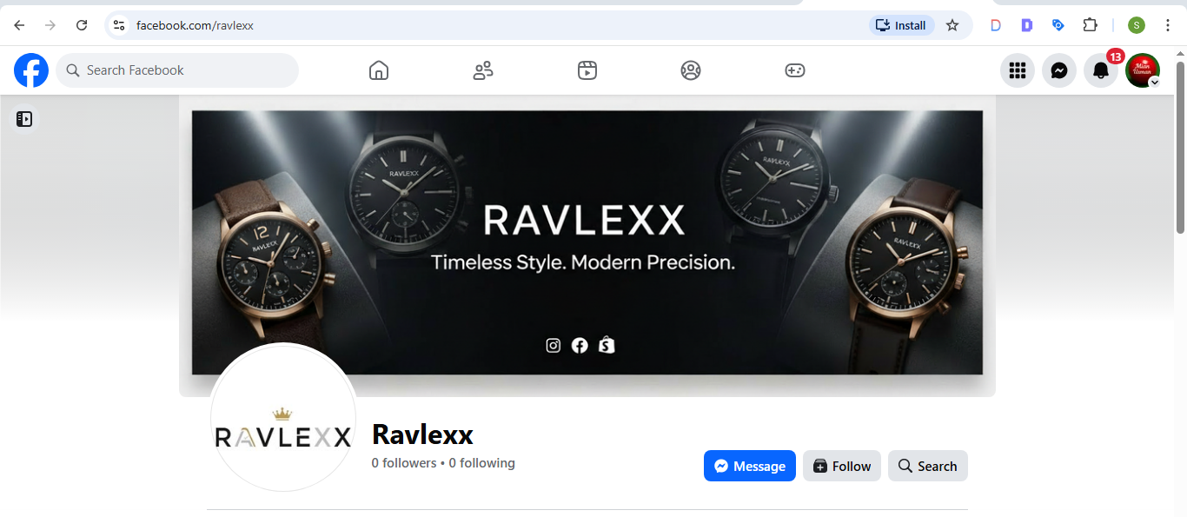
FACEBOOK LOGO AND COVER PHOTO:

Slide 48
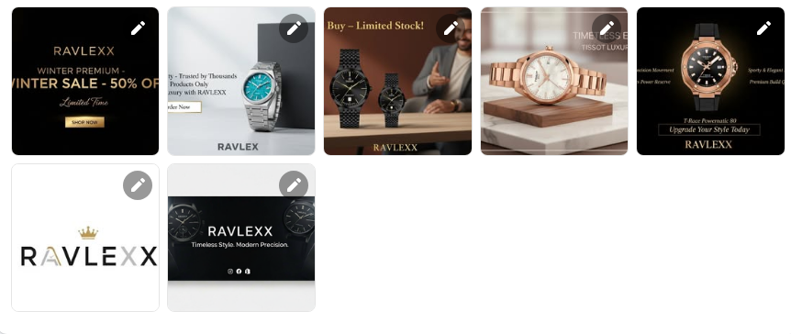
POSTS & REELS:

Slide 49
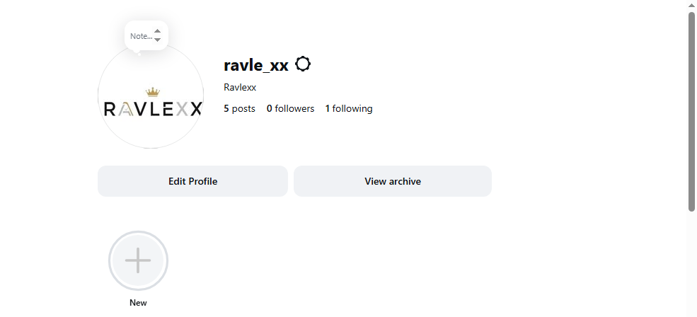
INSTAGRAM BUSSNIESS PAGE:

Slide 50
Thank u for watching

